Slide 1
Designing custom inconsistent knowledge graphs
MSc Artificial Intelligence Master Thesis
Thomas de Groot

Slide 2
Overview
Introduction
Background
Approach
Method
Internal Validation
Applications
External Validation
Conclusion

Slide 3
Introduction

Slide 4
Research Questions
RQ1: Can we define a formal definition?
RQ2: How can we retrieve these patterns?
RQ3: Can we classify the patterns?
RQ4: Can we design methods using patterns?

Slide 5
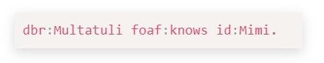
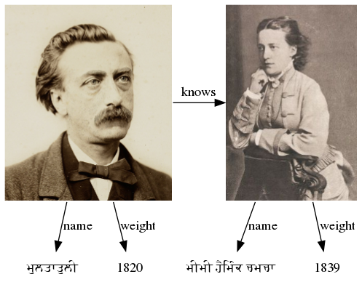
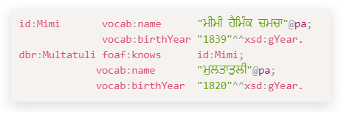
Background
Triple
Graph
Graphical Representation

Slide 6
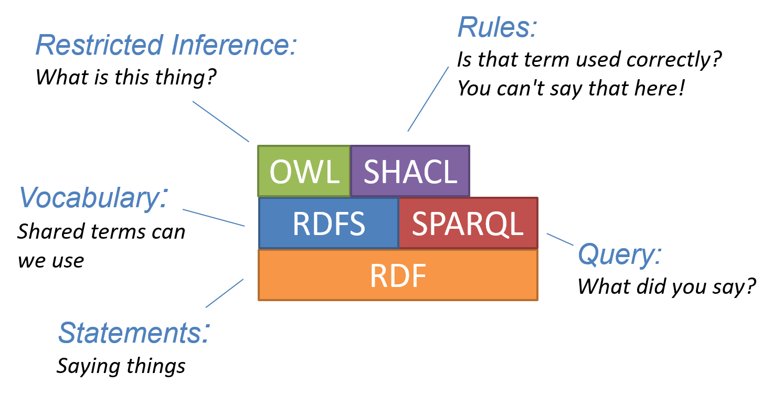
Background

Slide 7
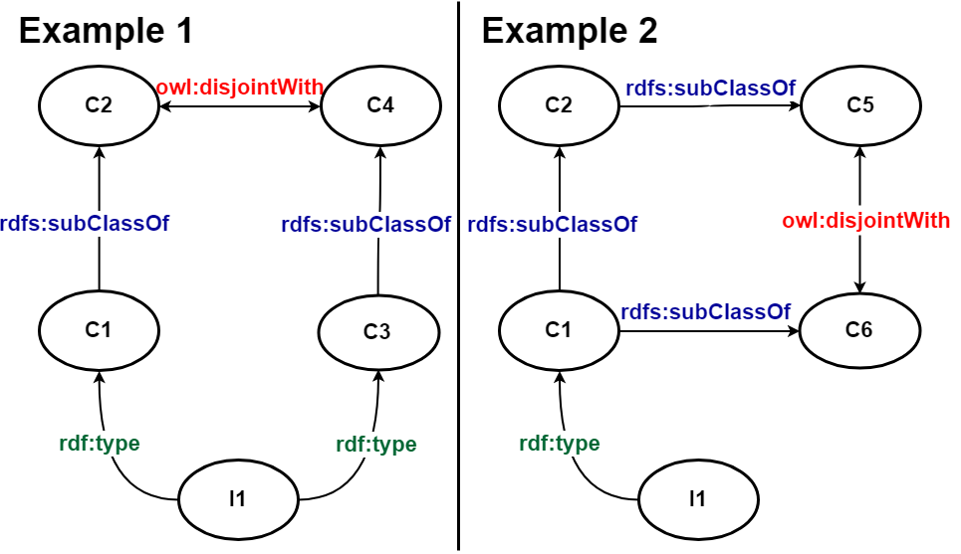
Background

Slide 8
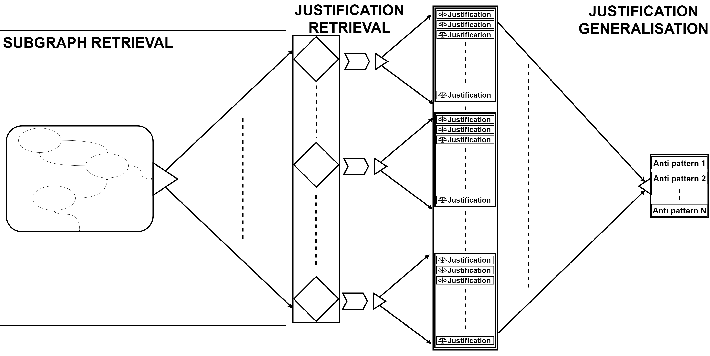
Approach

Slide 9
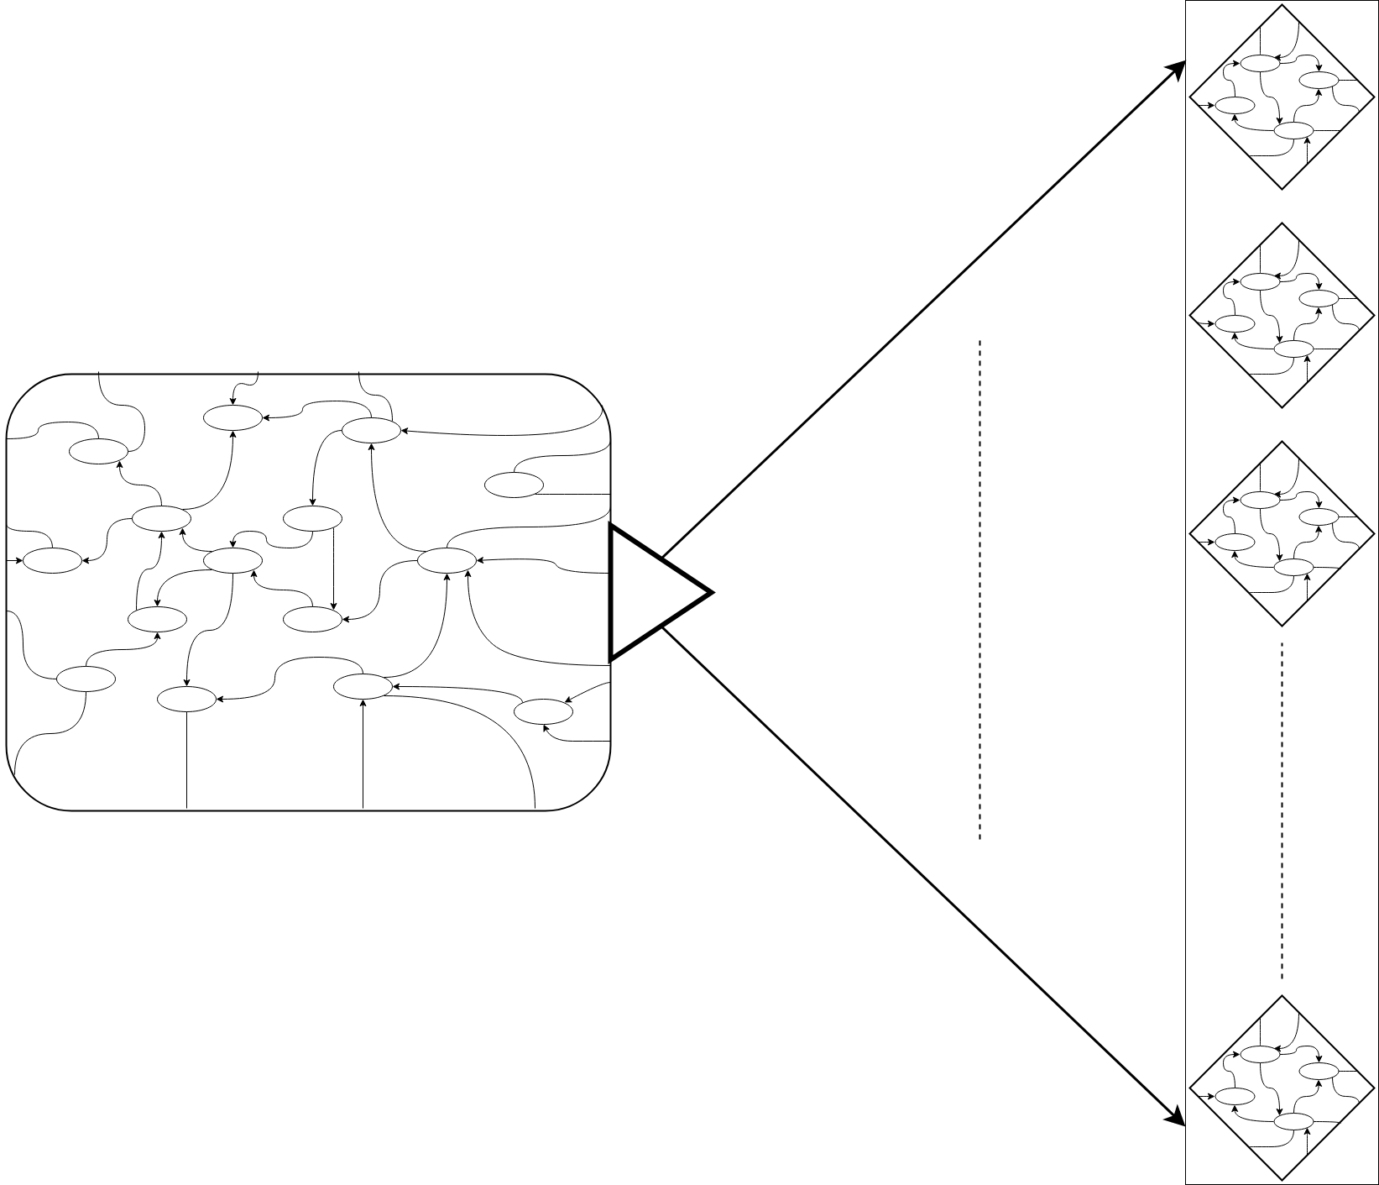
Method
Impractical to retrieve contradictions from the complete graph
Splitting the graph into smaller graphs most viable method
Possible to break existing contradictions
Implement redundancy to combat.

Slide 10
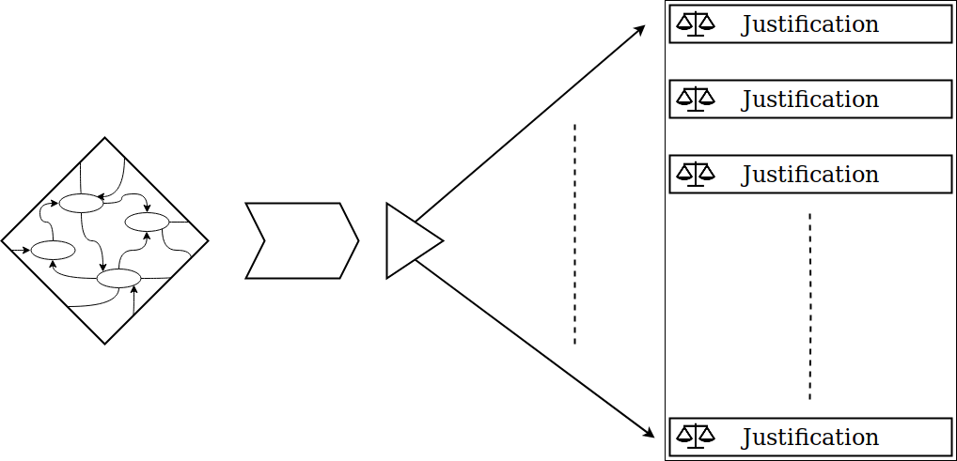
Method
Check if the subgraph is consistent
When the graph is inconsistent retrieve the reasons why.
Find the minimal justification for each contradiction.

Slide 11
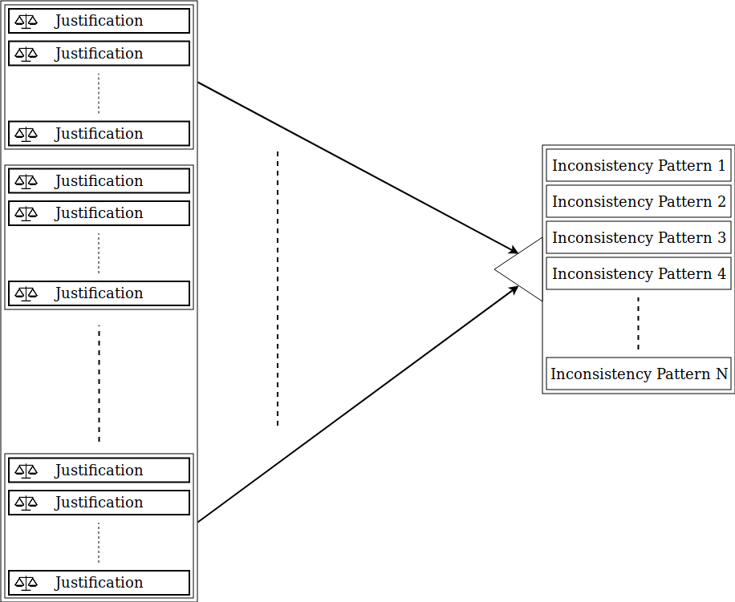
Method
Each justification is transformed in their Inconsistency pattern.
If the consistency pattern is not yet known it is added to the list of inconsistencies.

Slide 12
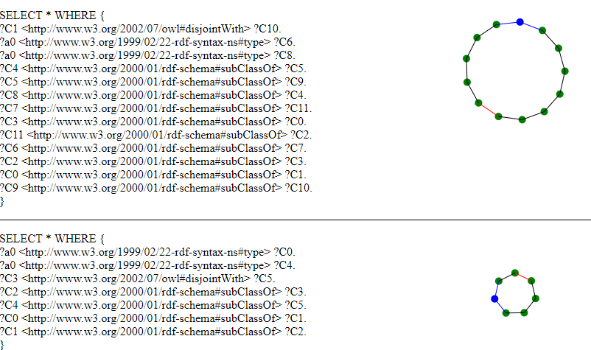
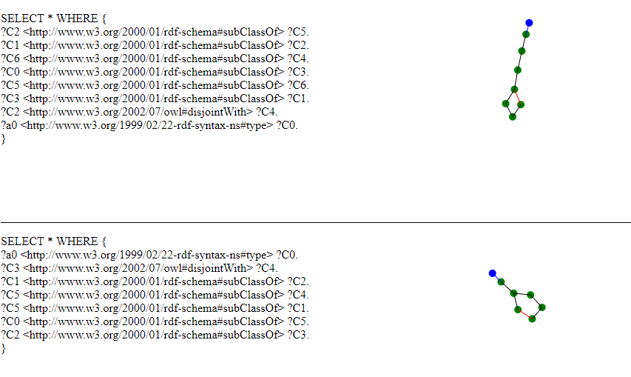
Internal validation

Slide 13
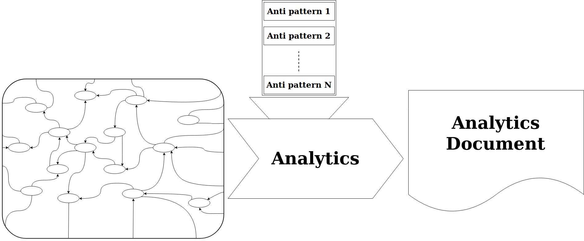
Applications

Slide 14
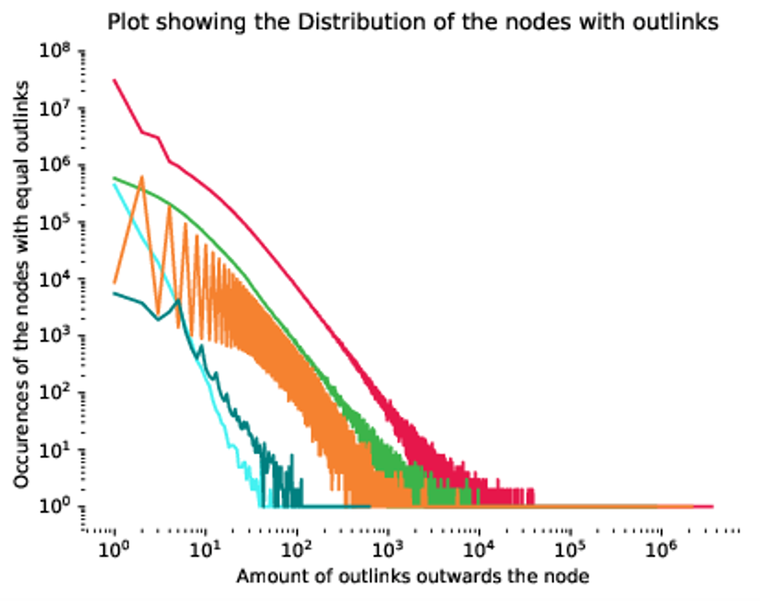
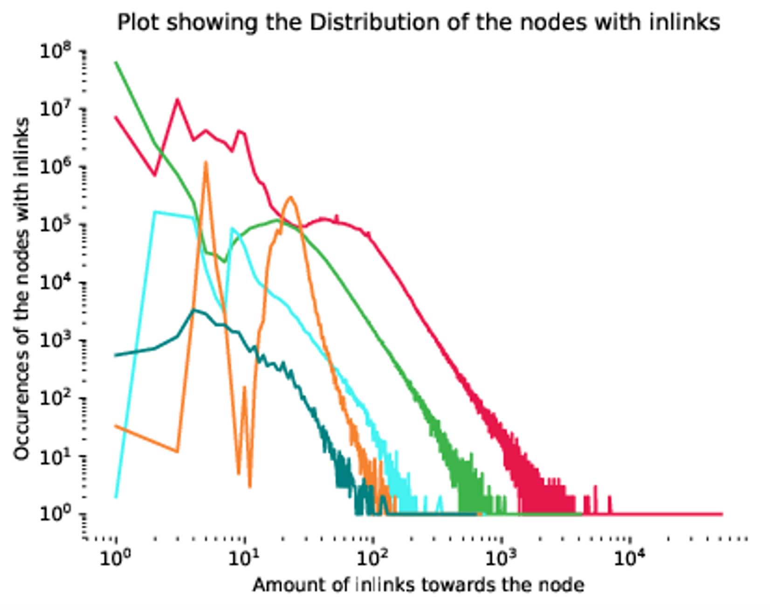

Slide 15
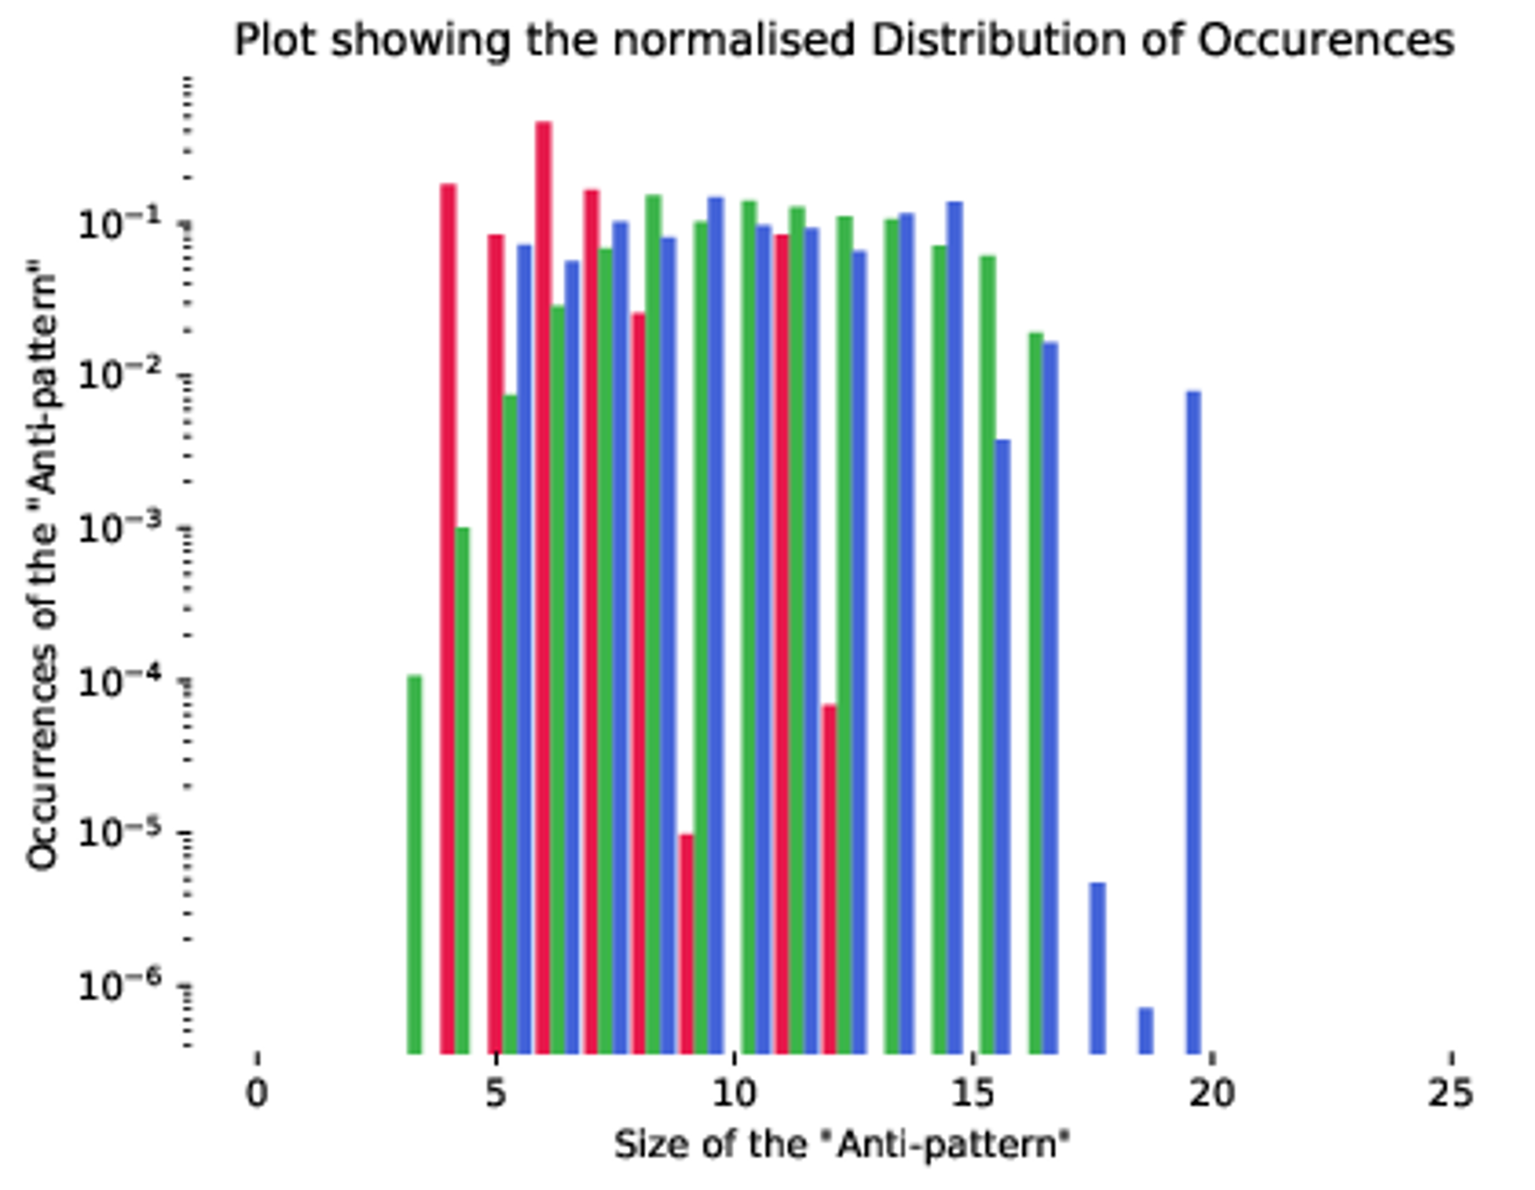
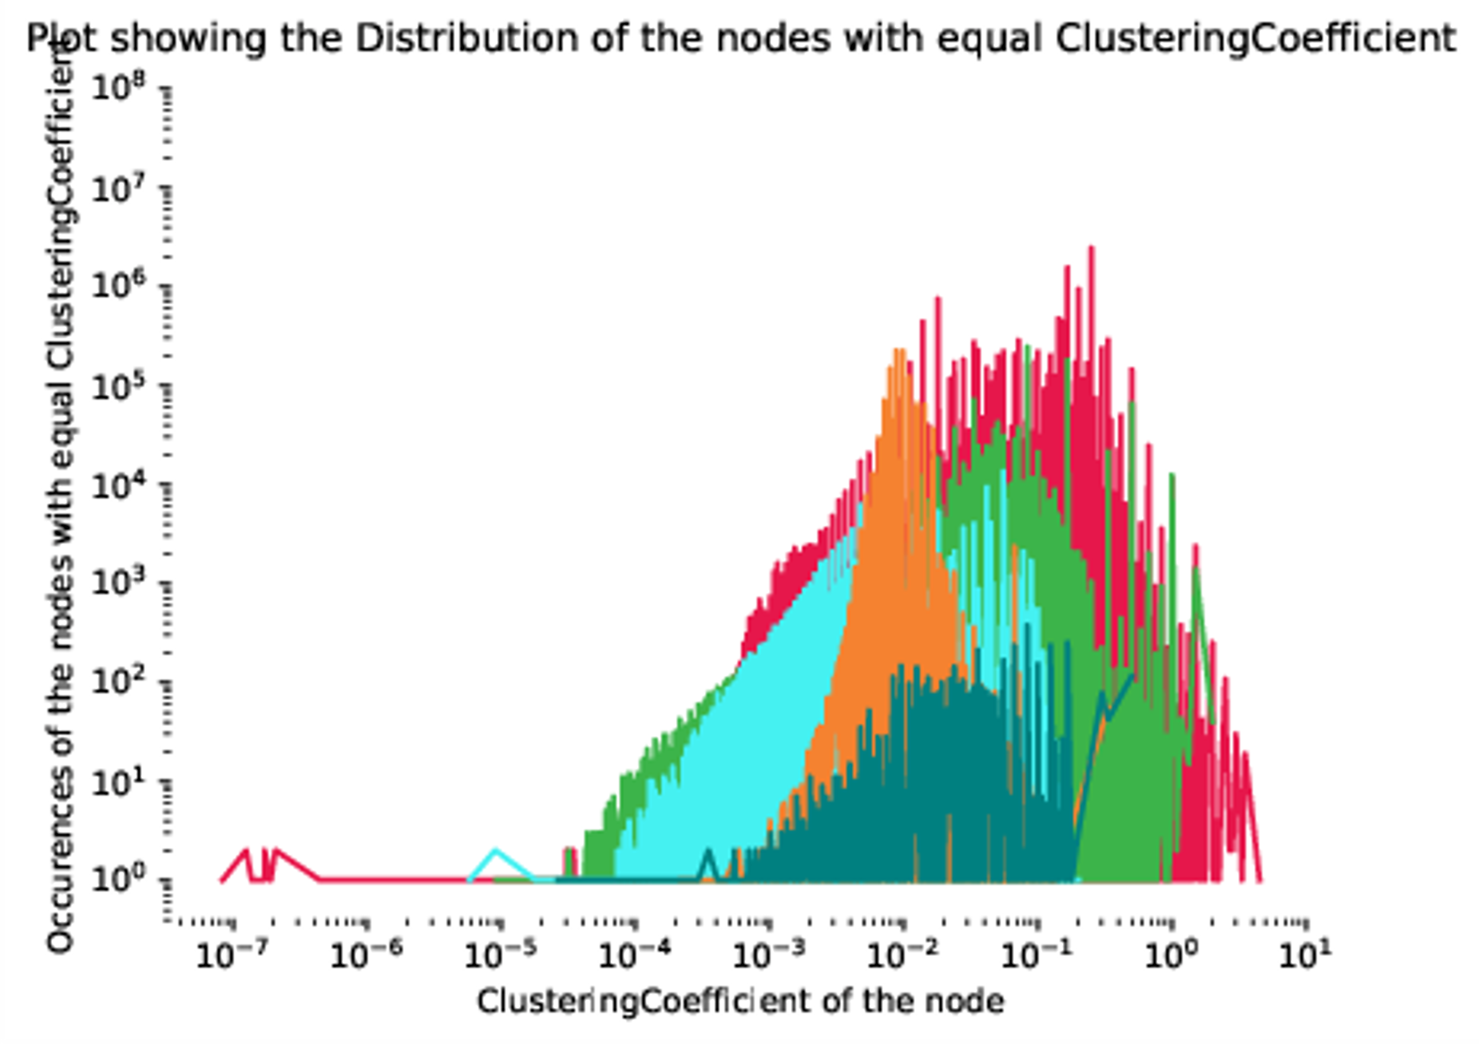

Slide 16
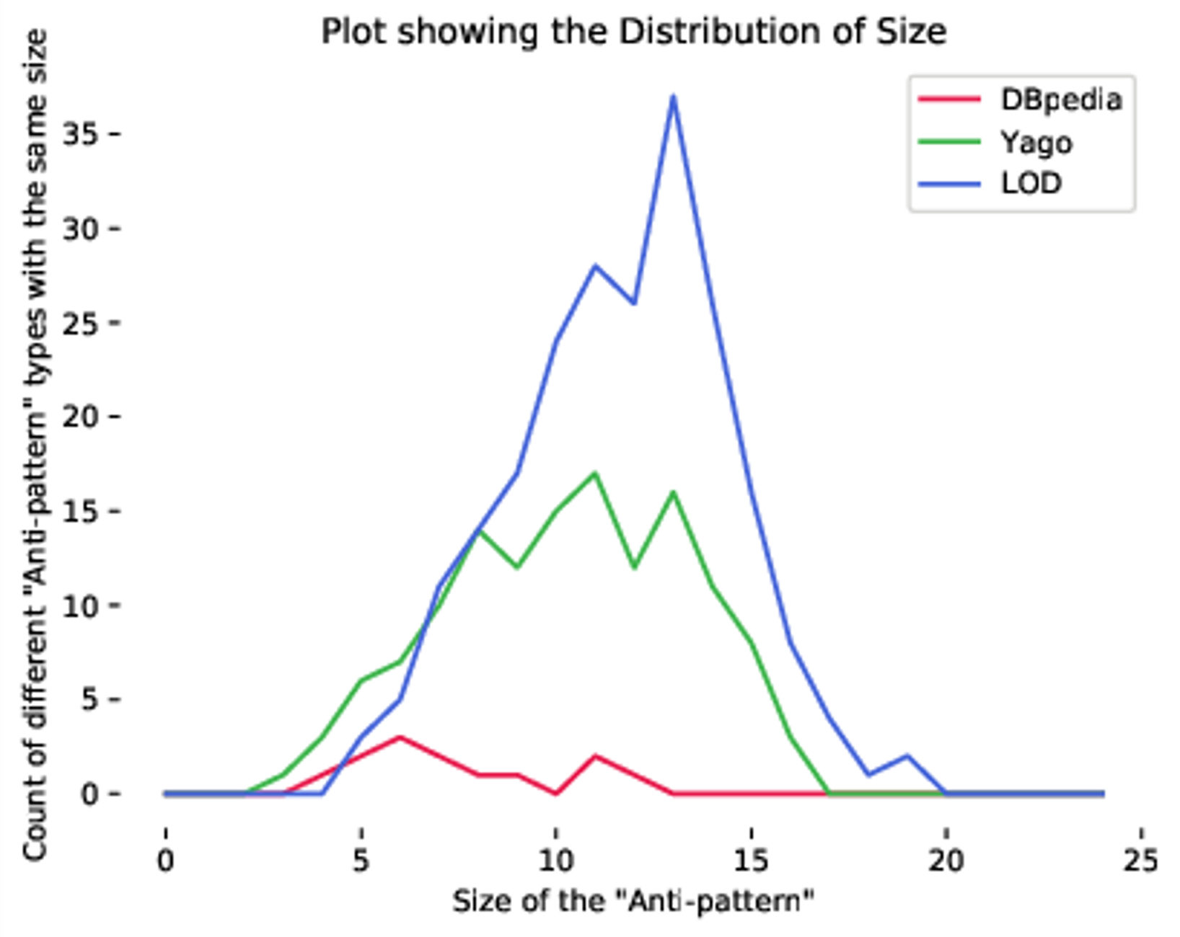
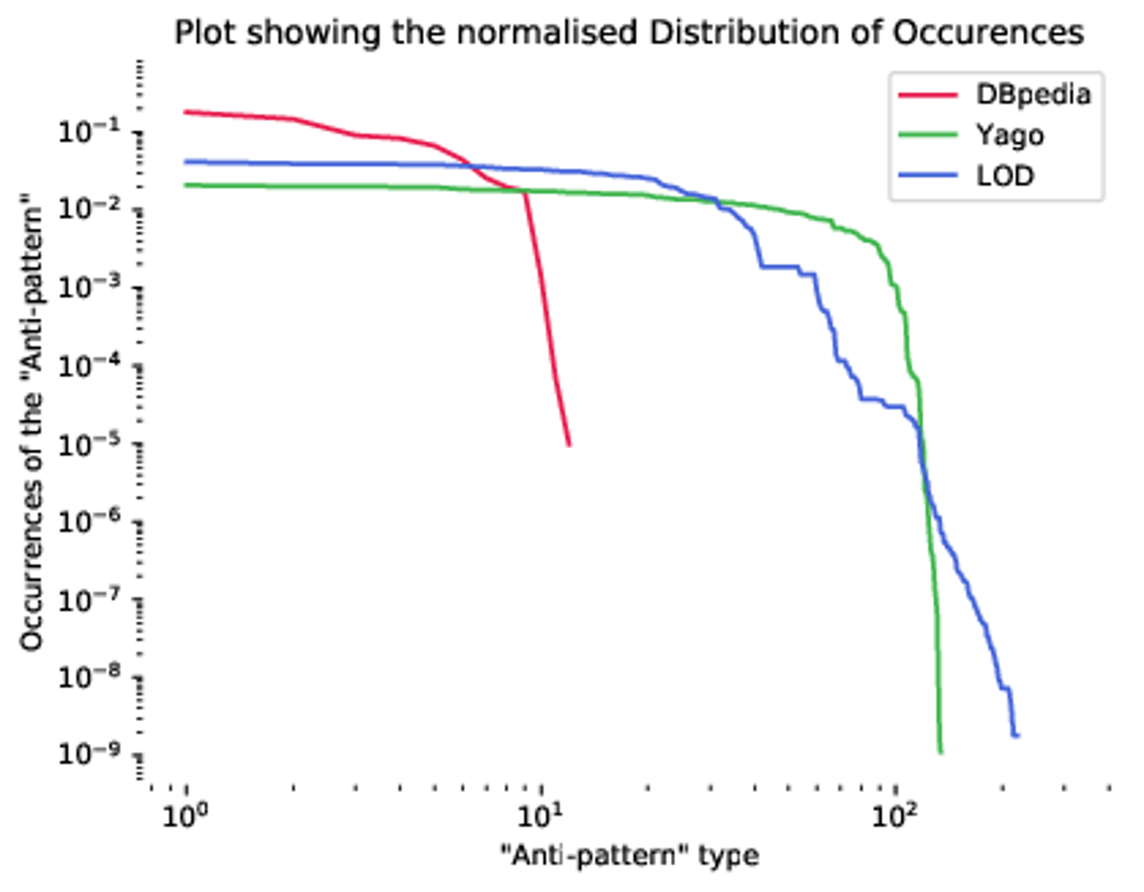

Slide 17
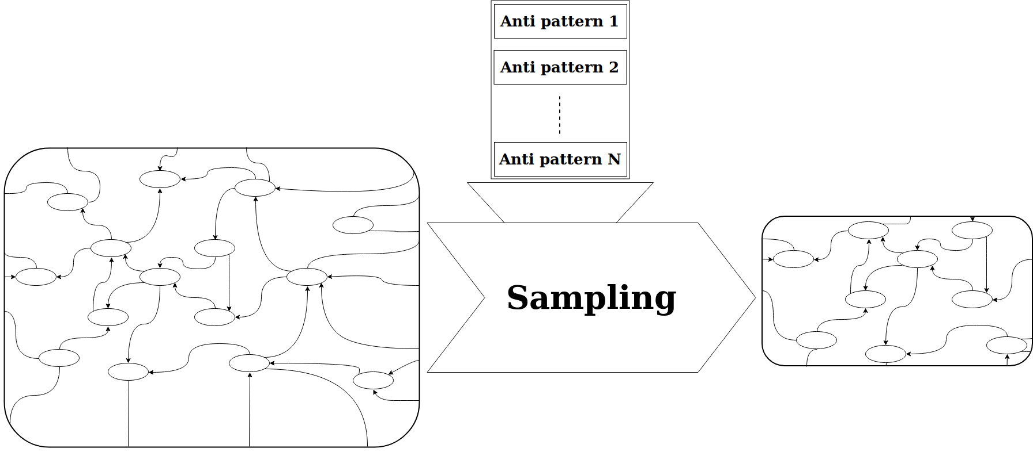
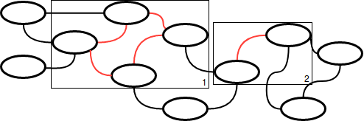
Applications

Slide 18
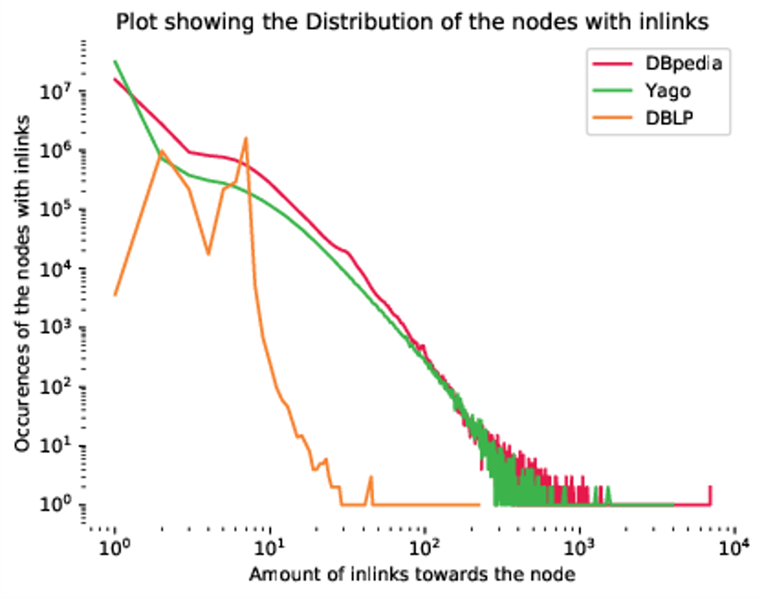
External validation

Slide 19
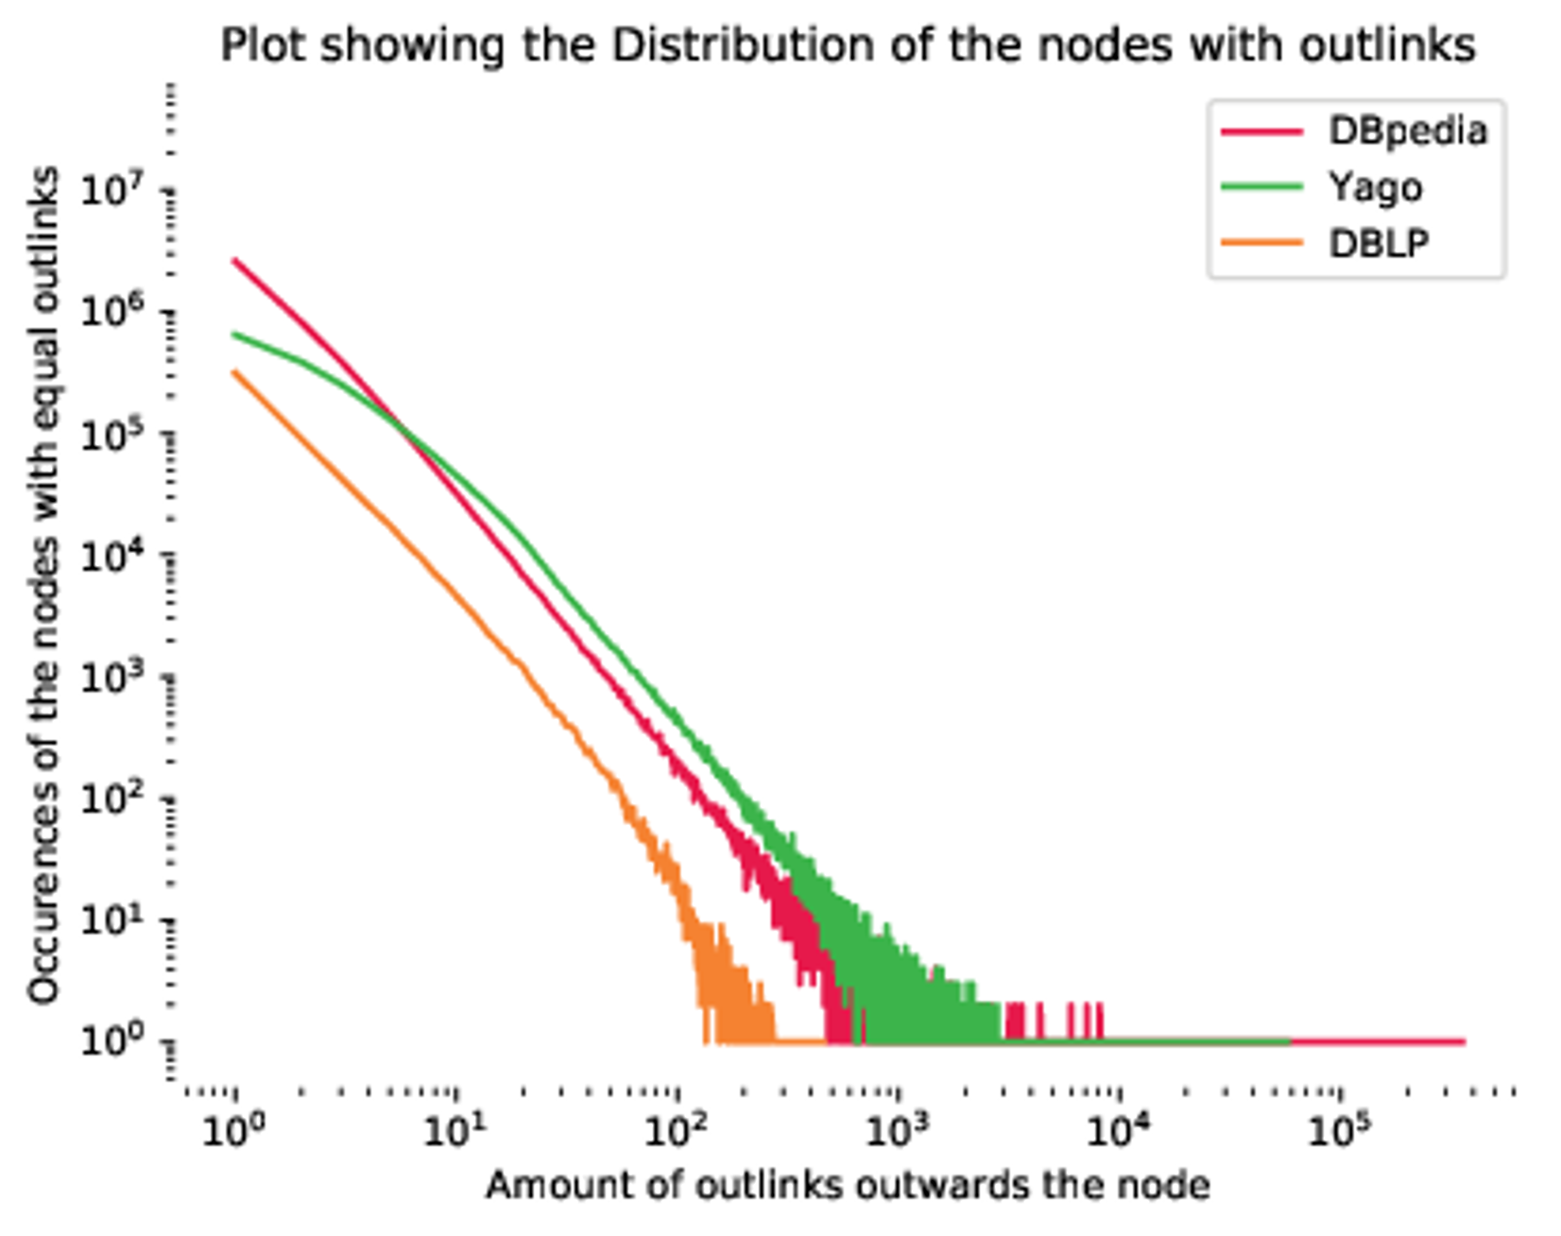

Slide 20
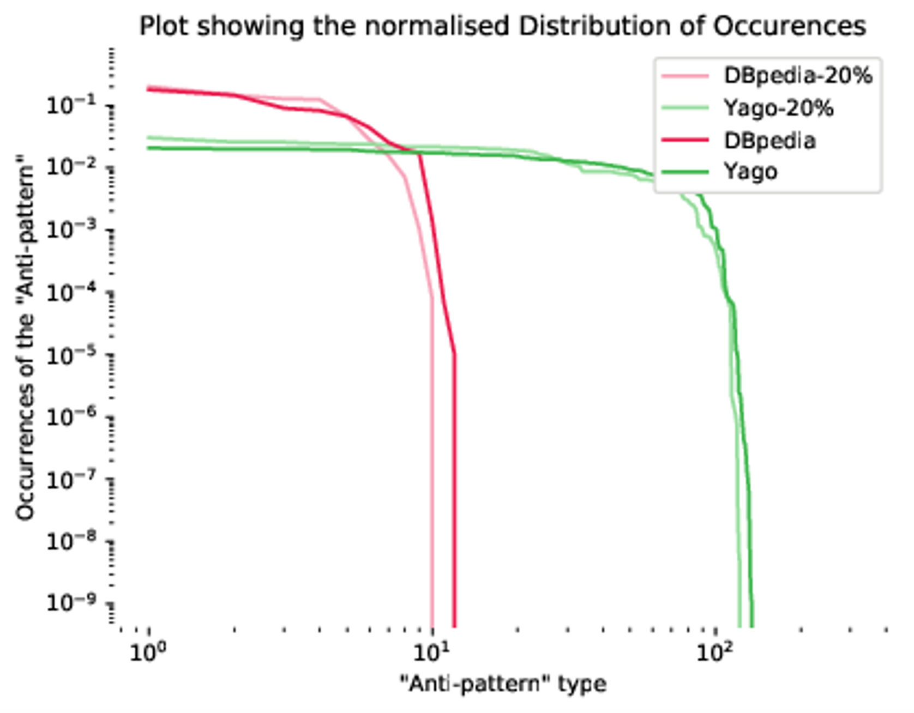
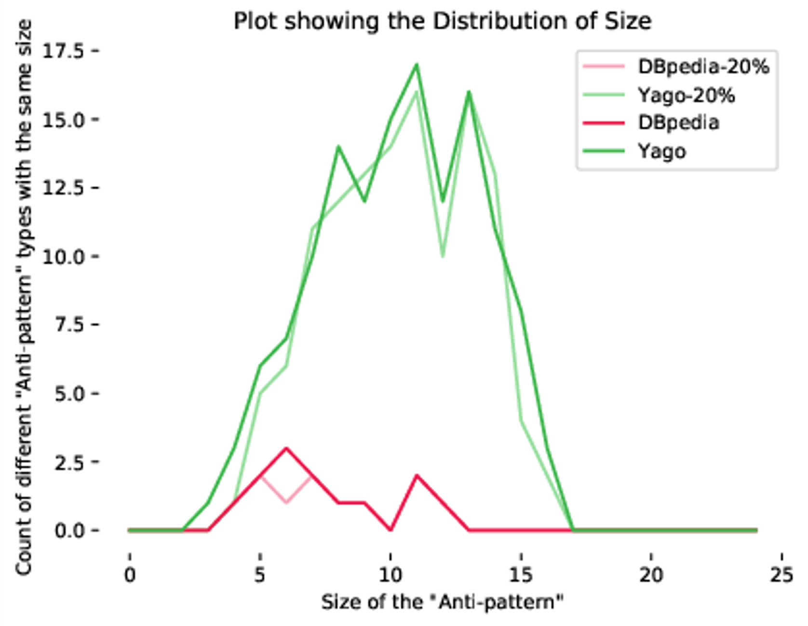

Slide 21
Conclusion

Slide 22
Future Work

